Slide 1
Internet Protocol Demonstration
RA1911028010071-Pavan Sai. K
RA1911028010074-Aayush Singh
RA1911028010081-Subhojeet Bhattacharjee

Slide 2
Summary
In the world of technology, there are vast numbers of users communicating with different devices in different languages. That also includes many ways in which they transmit data along with the different software they implement. So, communicating worldwide will not be possible if there were no fixed 'standards' that will govern the way user communicates for data as well as the way our devices treat those data. With this project, we aim to demonstrate IP address resolution, working of E-mail and File transferring from a remote computer using Cisco Packet Tracer.

Slide 3

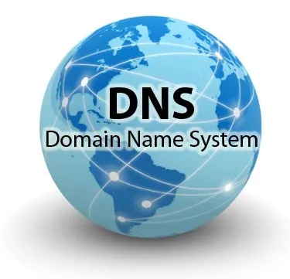
Requirements
DHCP Server: A DHCP Server is a network server that automatically provides and assigns IP addresses, default gateways and other network parameters to client devices. It relies on the standard protocol known as Dynamic Host Configuration Protocol or DHCP to respond to broadcast queries by clients.
DNS Server: A DNS server is a computer server that contains a database of public IP addresses and their associated hostnames, and in most cases serves to resolve, or translate, those names to IP addresses as requested.

Slide 4
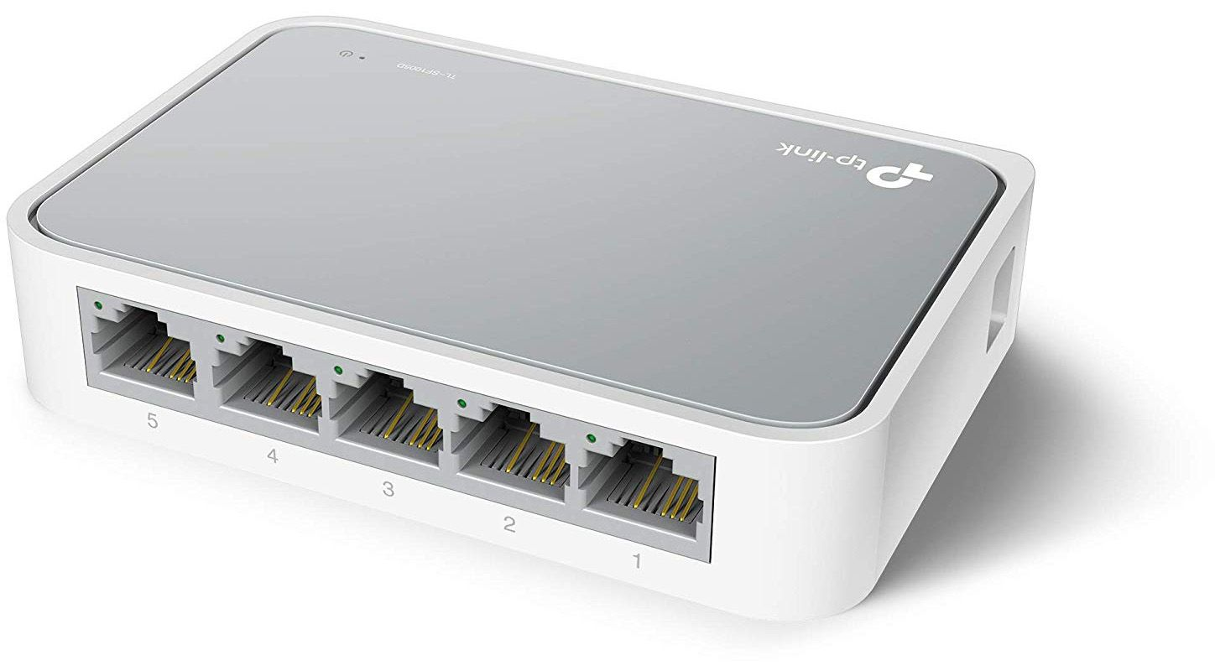

Web server: A web server is software and hardware that uses HTTP(Hypertext Transfer Protocol) and other protocols to respond to client requests made over the World Wide Web. The main job of a web server is to display website content through storing, processing and delivering webpages to users.
Switch: Switches are key building blocks for any network. They connect multiple devices, such as computers, wireless access points, printers, and servers; on the same network within a building or campus. A switch enables connected devices to share information and talk to each other.

Slide 5

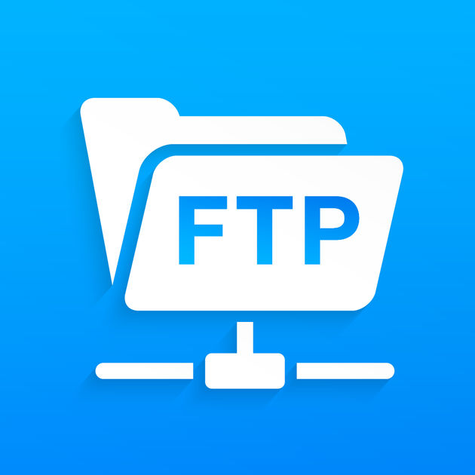
FTP Server : The primary purpose of an FTP server is to allow users to upload and download files. An FTP server is a computer that has a file transfer protocol (FTP) address and is dedicated to receiving an FTP connection. FTP is a protocol used to transfer files via the internet between a server (sender) and a client (receiver).
Email Server : An email server, or simply mail server, is an application or computer in a network whose sole purpose is to act as a virtual post office. The server stores incoming mail for distribution to local users and sends out outgoing messages. This uses a client-server application model to send and receive messages using Simple Mail Transfer Protocol (SMTP)

Slide 6
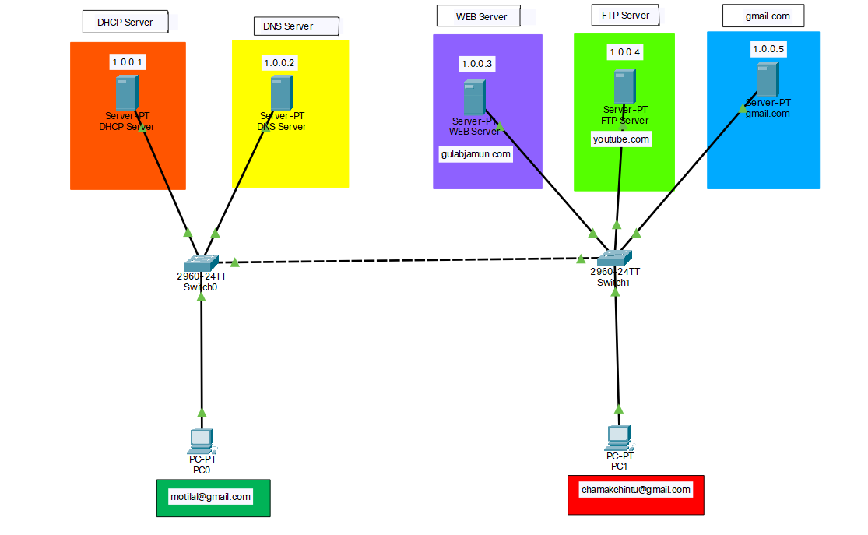
Architecture & Design

Slide 7
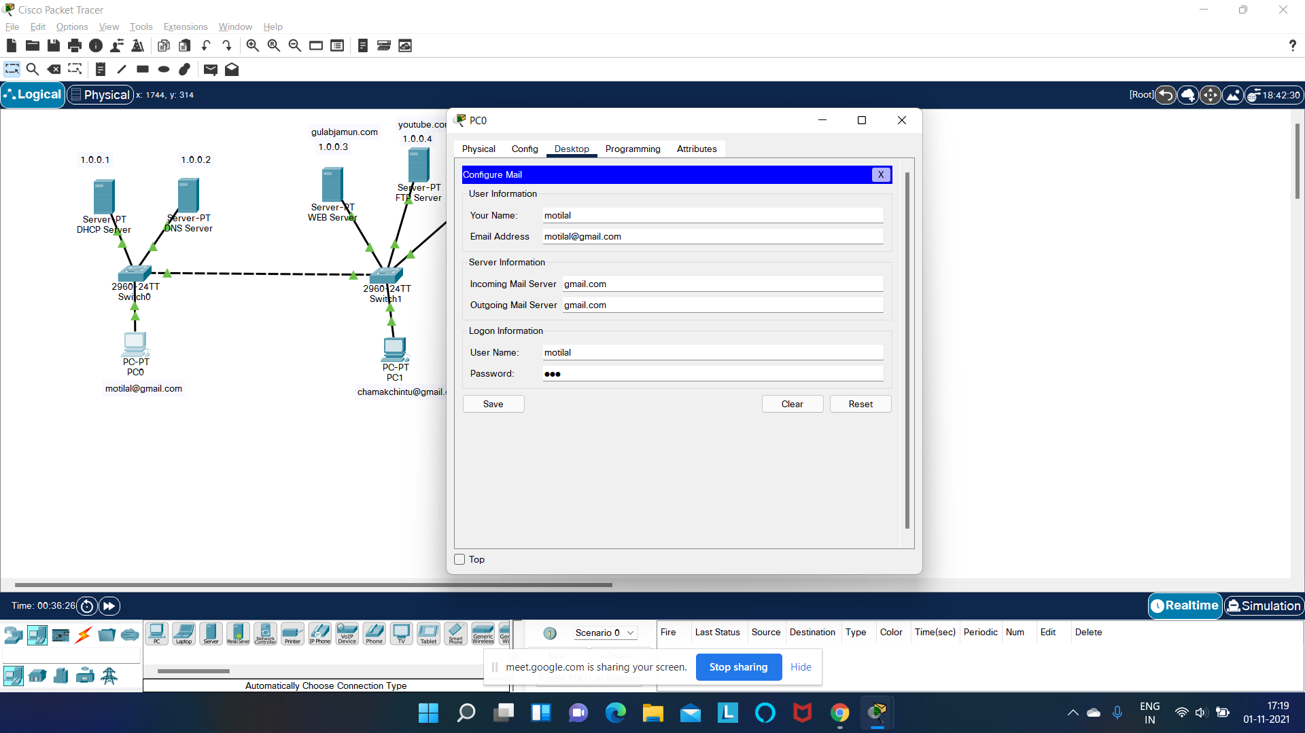
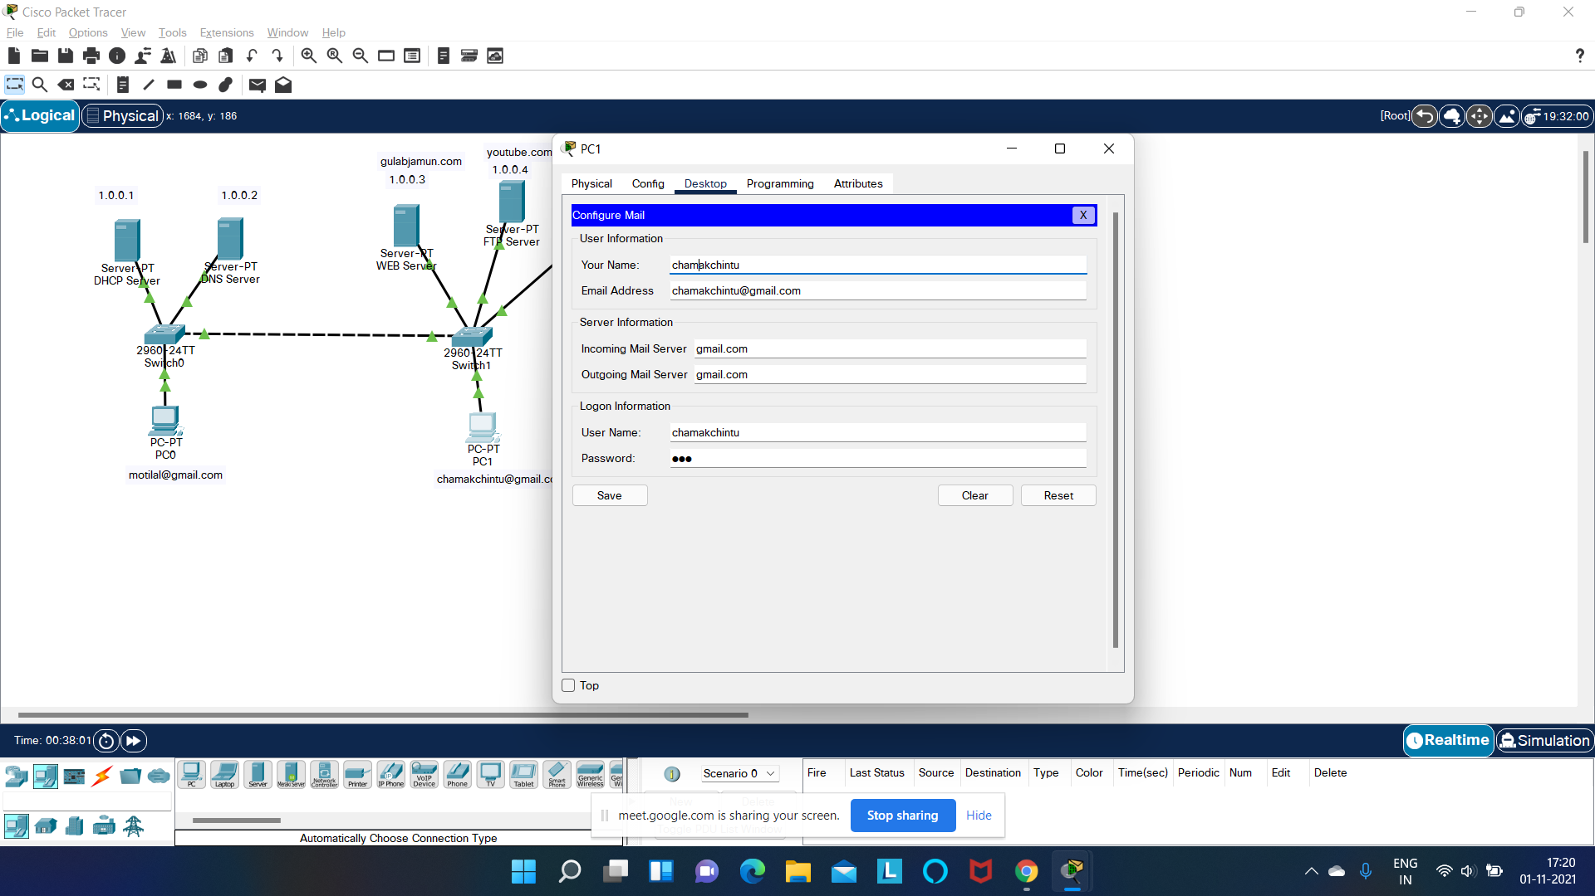
USERS
MOTILAL
CHAMAK CHINTU

Slide 8
DHCP
DHCP is a service that permits network administrators to set up servers to allocate and manage collections of IP addresses for workstations, desktop computers, and other client machines that do not require fixed IP addresses.
DHCP can also supply important IP configuration data for clients, including the subnet mask, the local IP gateway (router) address, and even DNS and WINS data, where needed or appropriate.
DHCP servers can manage one or more ranges of IP addresses, each of which may be called an address pool (if considered as a range of available addresses from which unused addresses may be allocated), or an address scope (if considered as a range of numeric IP addresses that fall under DHCPs control)

Slide 9
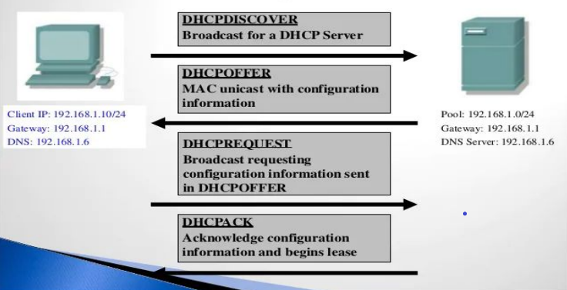
DHCP Architecture

Slide 10
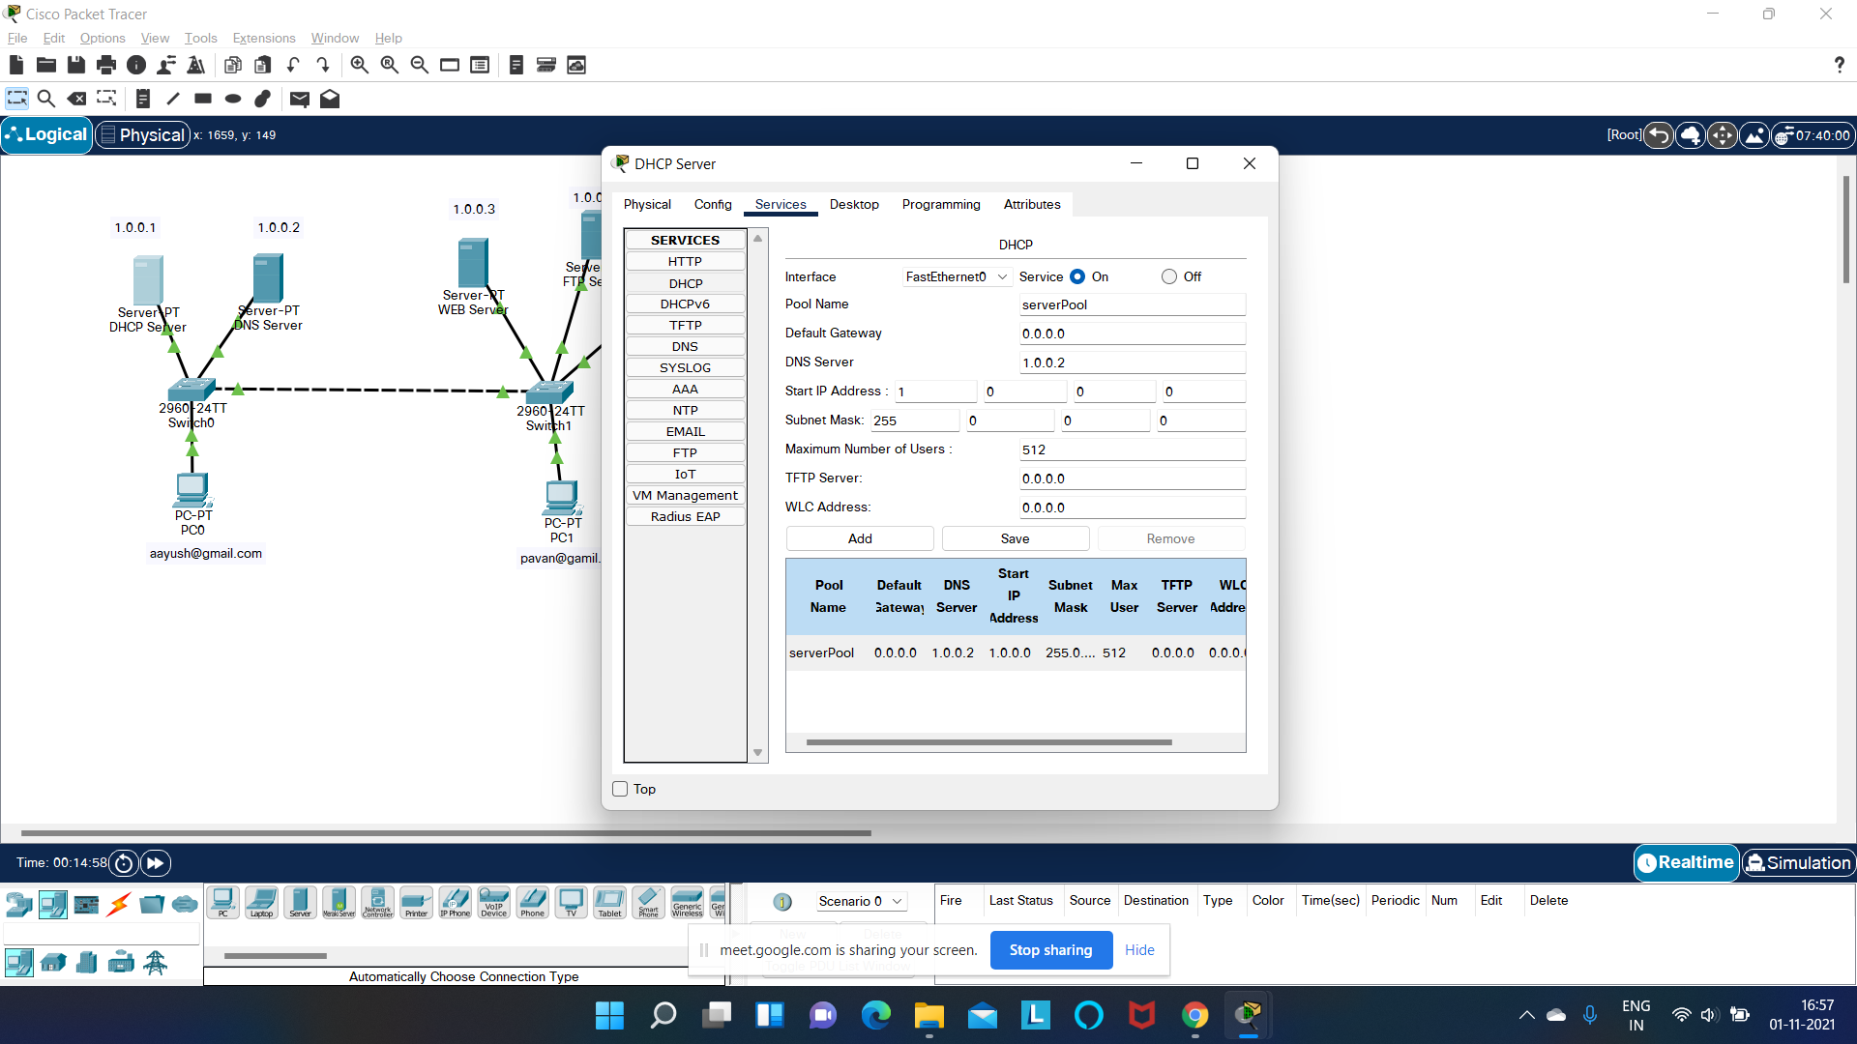
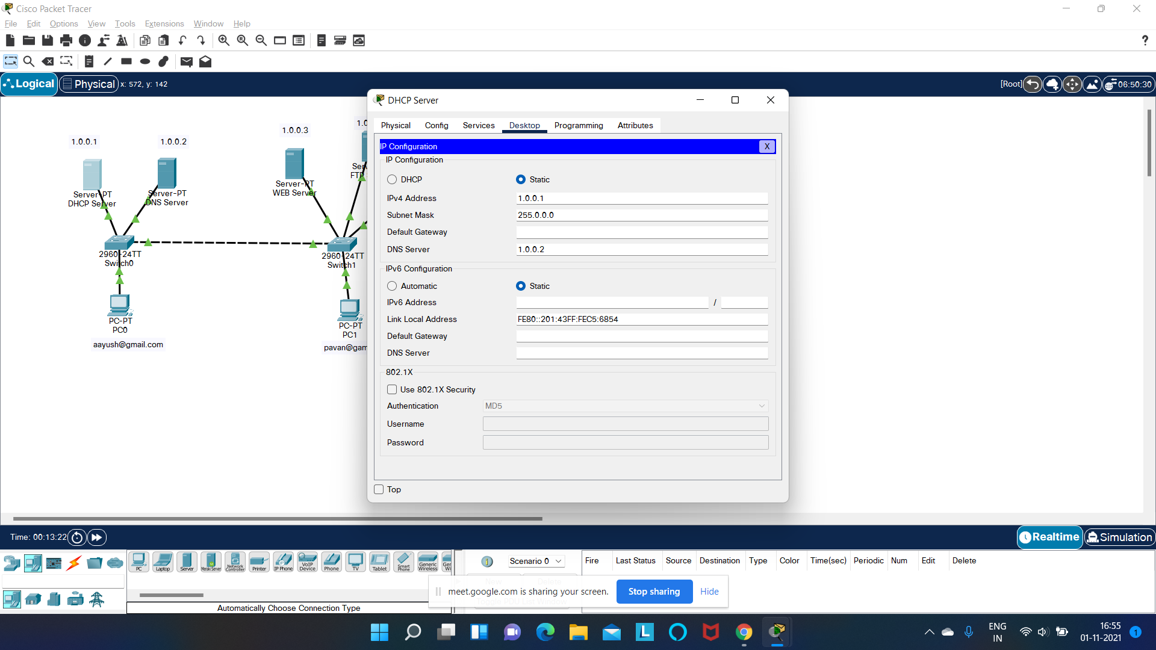
Project Demo

Slide 11
DNS Architecture
Domain Name Servers or DNS are very similar to a phone book that contains all the public domains and their corresponding IP Addresses. DNS is an internet service that translates the domain name into IP addresses.
Whenever you request for google.com or any other website, your request first goes to DNS servers. Then, the DNS server translates the domain into the corresponding IP Address and forwards the request to the website server, and finally the website loads into your browser.

Slide 12
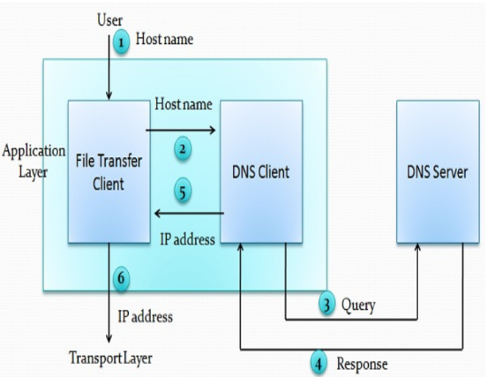
DNS Architecture

Slide 13
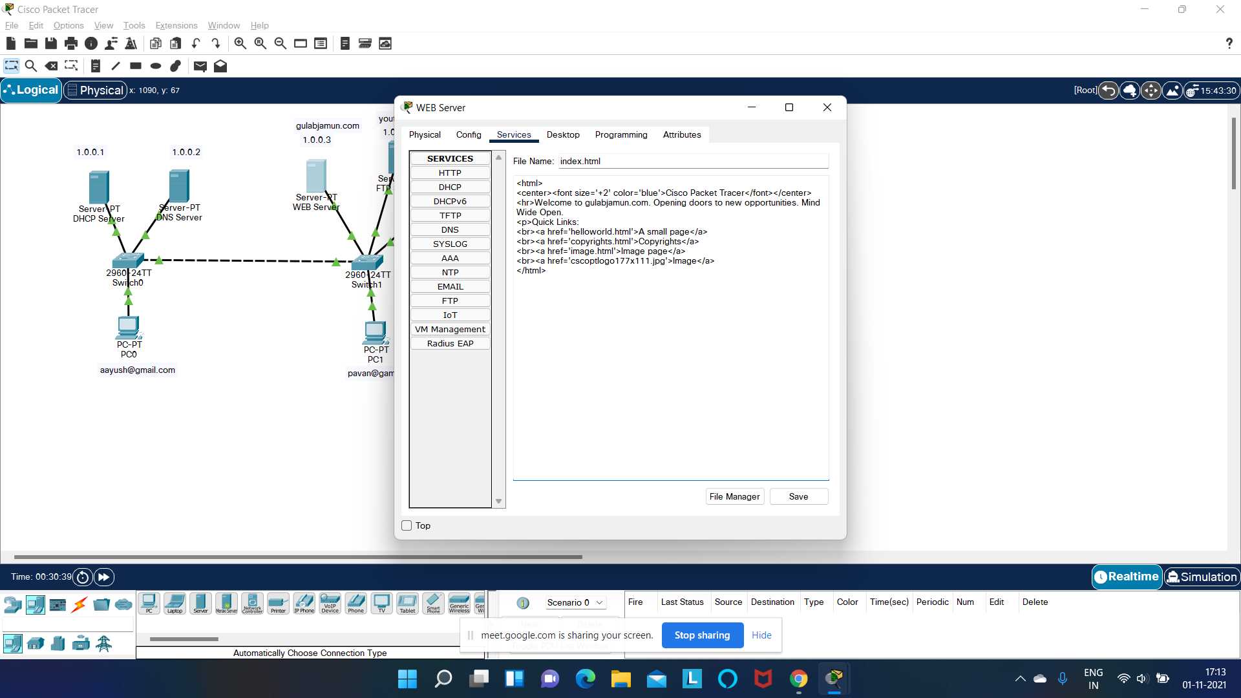
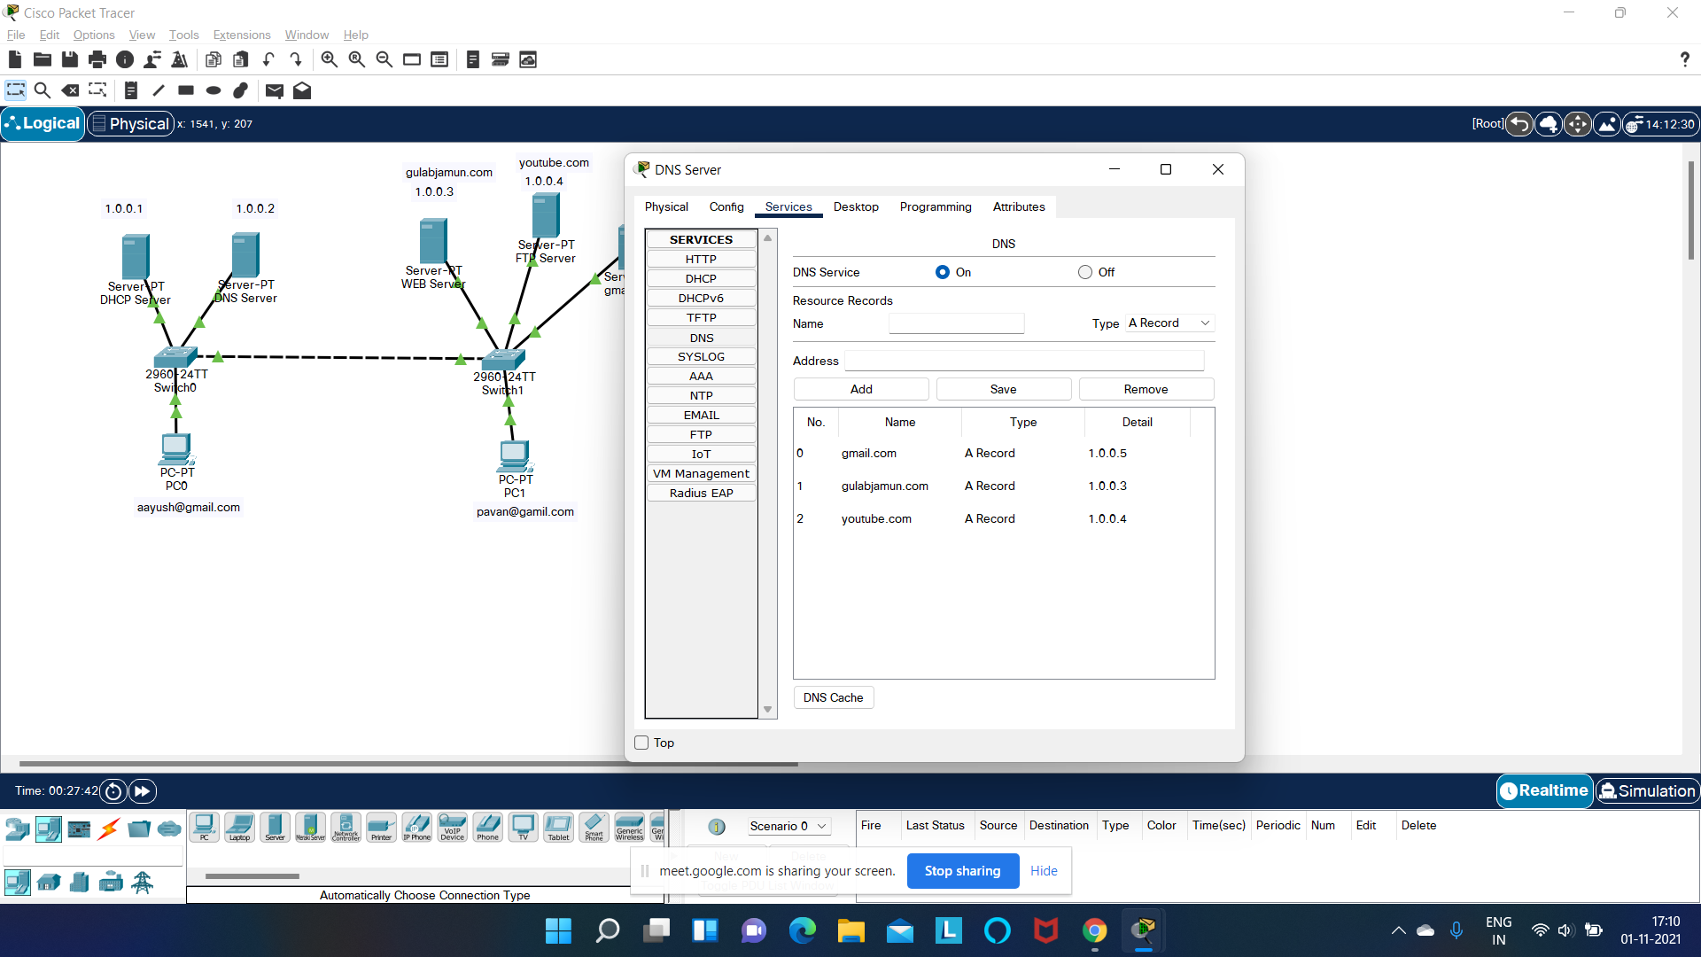
Project Demo

Slide 14
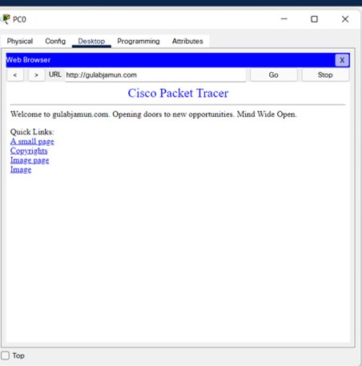

Slide 15
SMTP
SMTP is a set of communication guidelines that allow software to transmit an electronic mail over the internet is called Simple Mail Transfer Protocol. It is a program used for sending messages to other computer users based on e-mail addresses.
The main purpose of SMTP is used to set up communication rules between servers . The servers have a way of identifying themselves and announcing what kind of communication they are trying to perform. They also have a way of handling the errors such as incorrect email address. For example, if the recipient address is wrong, then receiving server reply with an error message of some kind.

Slide 16
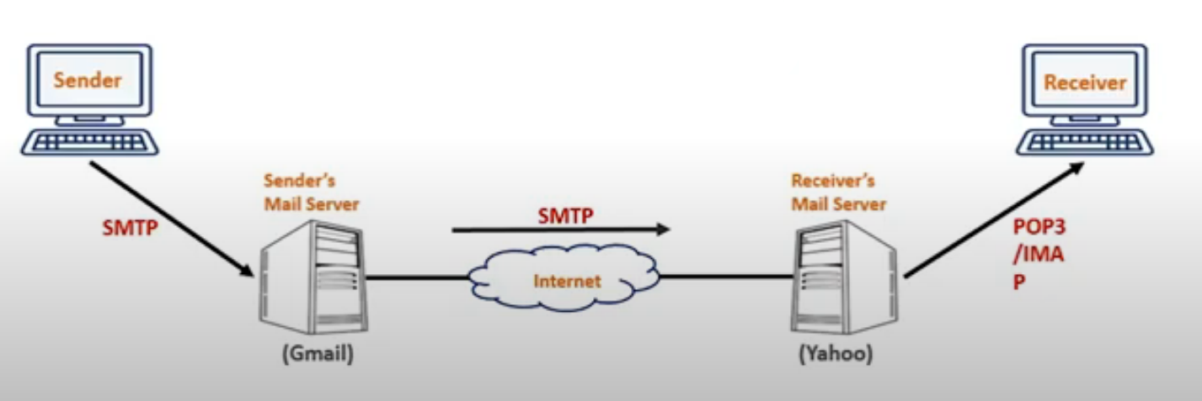
SMTP Architecture

Slide 17
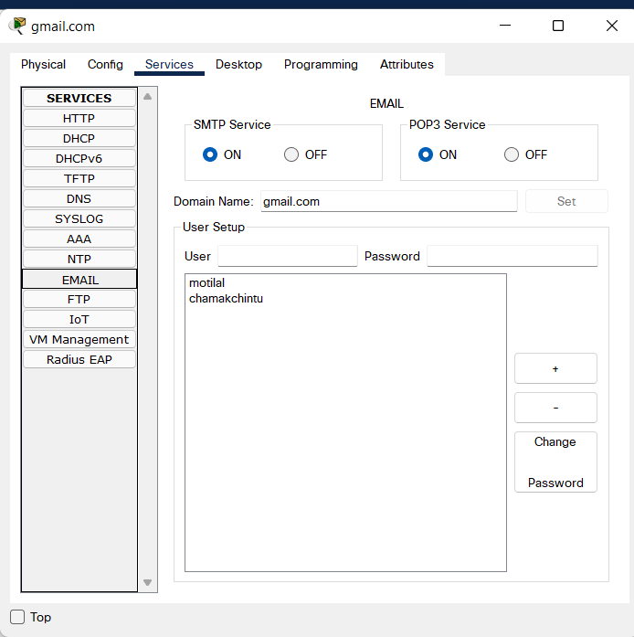
Project Demo

Slide 18
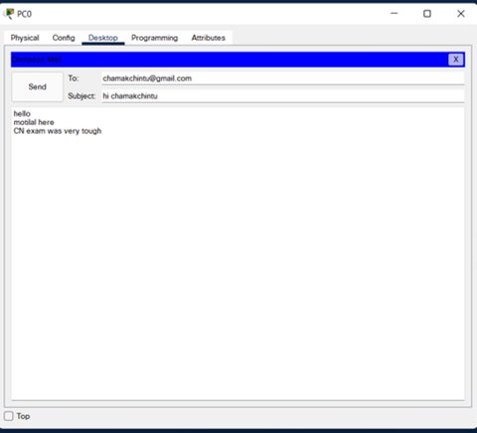
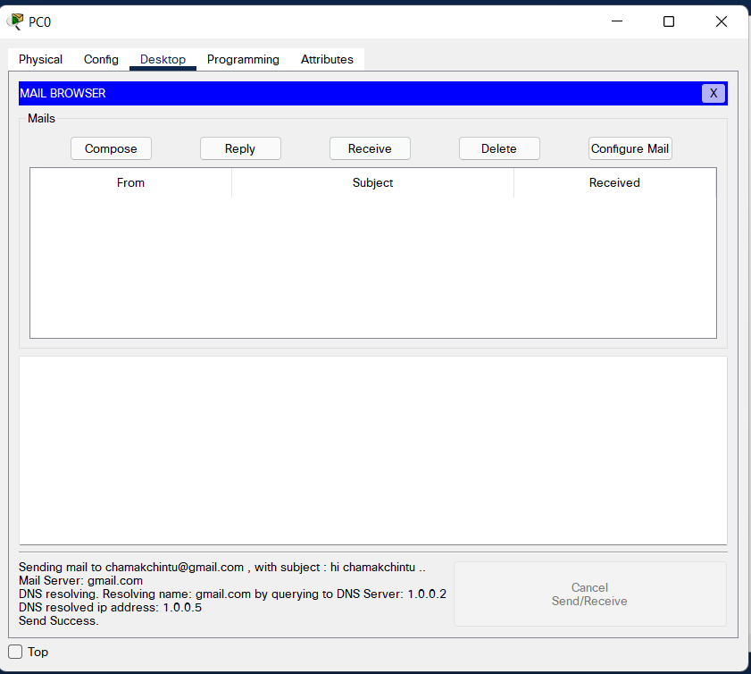

Slide 19
POP3
The client POP3 software is installed on the recipient computer; the server POP3 software is installed on the mail server. Mail access starts with the client when the user needs to download its e-mail from the mailbox.
The client opens a connection to the server on TCP port. It then sends its users name and password to access the mailbox. The user can then list and retrieve the mail messages, one by one.
POP3 is the most recent version of a standard protocol for receiving e-mail. It is a client/server protocol in which e-mail is received and held for you by your Internet server. POP3 is designed to delete mail on the server as soon as the user has downloaded it.

Slide 20
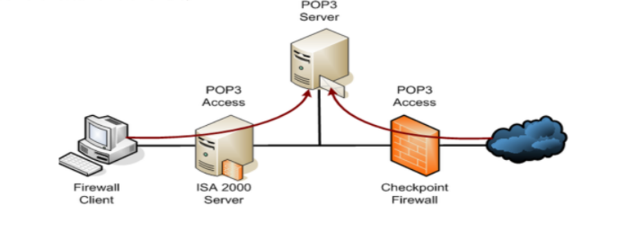
POP3 Architecture

Slide 21
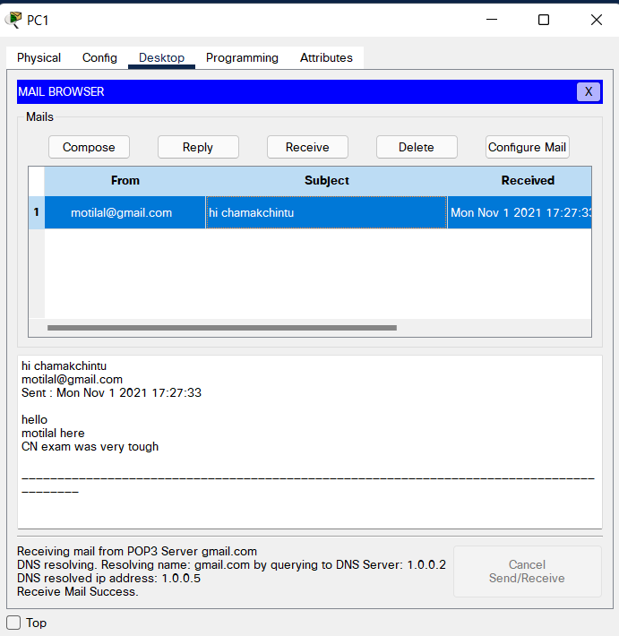
Project Demo

Slide 22
FTP
FTP (File Transfer Protocol) is the simplest and most secure way to exchange files over the Internet. Transferring files from a client computer to a server computer is called "uploading" and transferring from a server to a client is "downloading".
To access an FTP server, users must be able to connect to the Internet or an intranet (via a modem or local area network) with an FTP client program. FTP doesn’t really move, it copies files from one computer to another.
FTP is the file transfer protocol in the Internet's TCP/IP protocol suite’s Application Layer. An FTP Client is software that is designed to move files back-and-forth between two computers over the Internet.

Slide 23
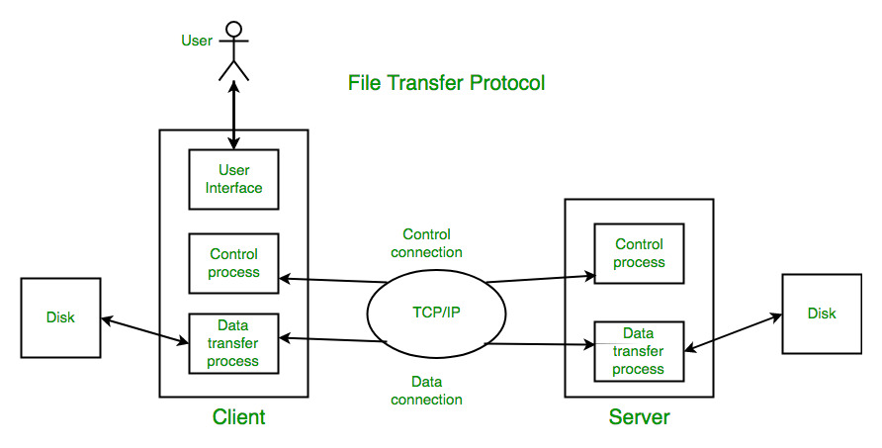
FTP Architecture

Slide 24
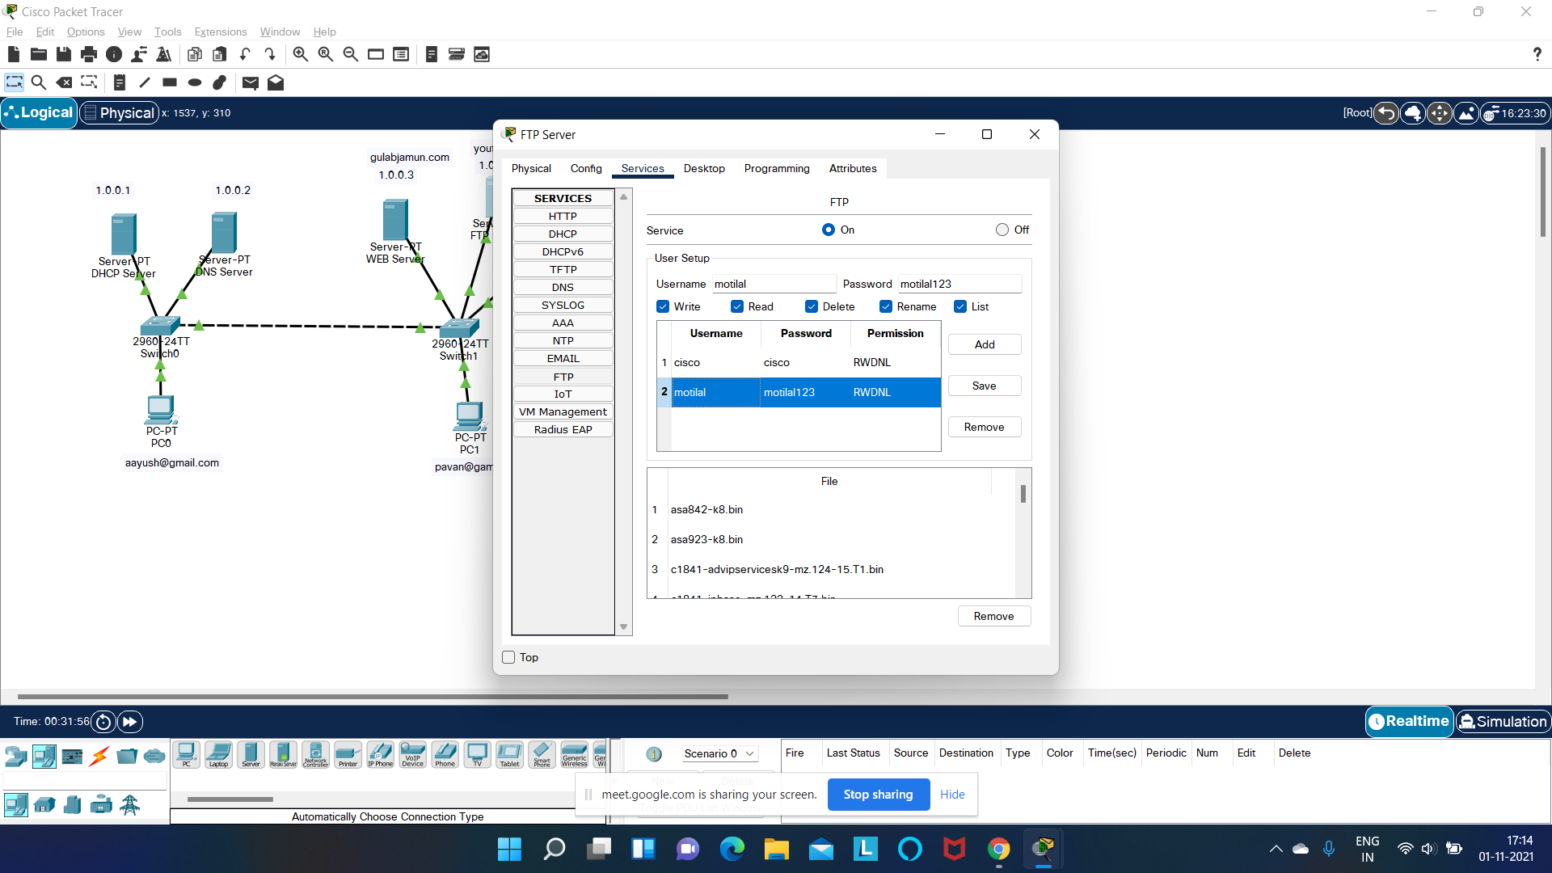
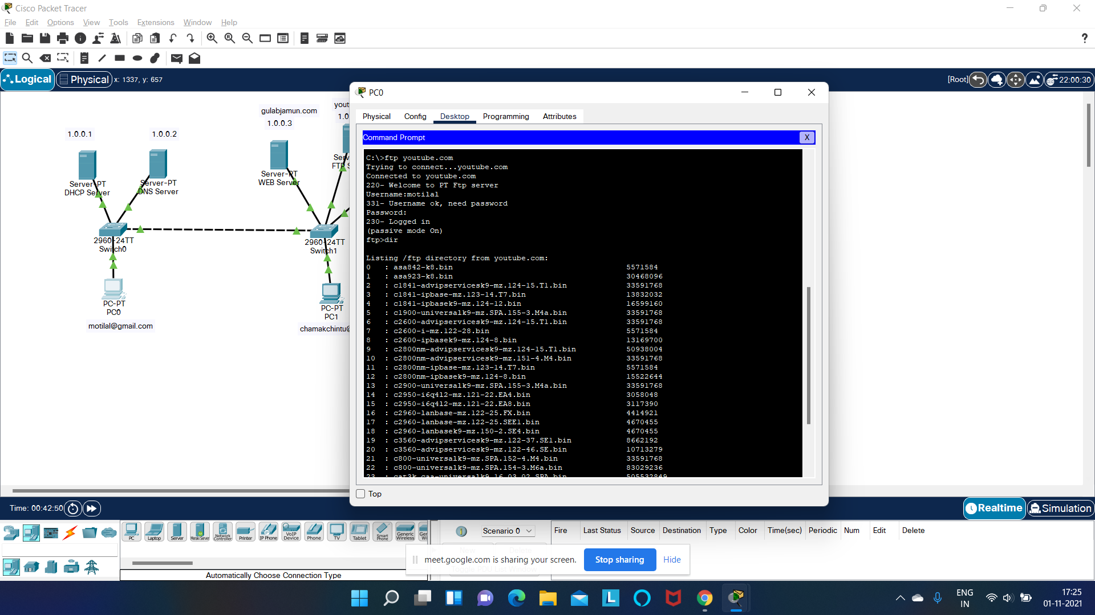
Project Demo

Slide 25

Please leave us

